Slide 1
Using R for Text Analysis:
A Github Repo and Tutorial Approach
Tassie Gniady @tassietheg
CyberDH Team, Research Technologies, UITS, Indiana University
cyberdh@iu.edu

Slide 2
What is R?
R is an open source language used for statistical computing and graphics. Its popularity among statisticians and data miners has risen significantly in recent years.
How does this help you?
R relies on "packages" to augment the base code and recent additions are of great use to those new to R, including
tm (text mining)
qdap (bridges qualitative data → quantitative analysis with parsing tools)
wordcloud

Slide 3
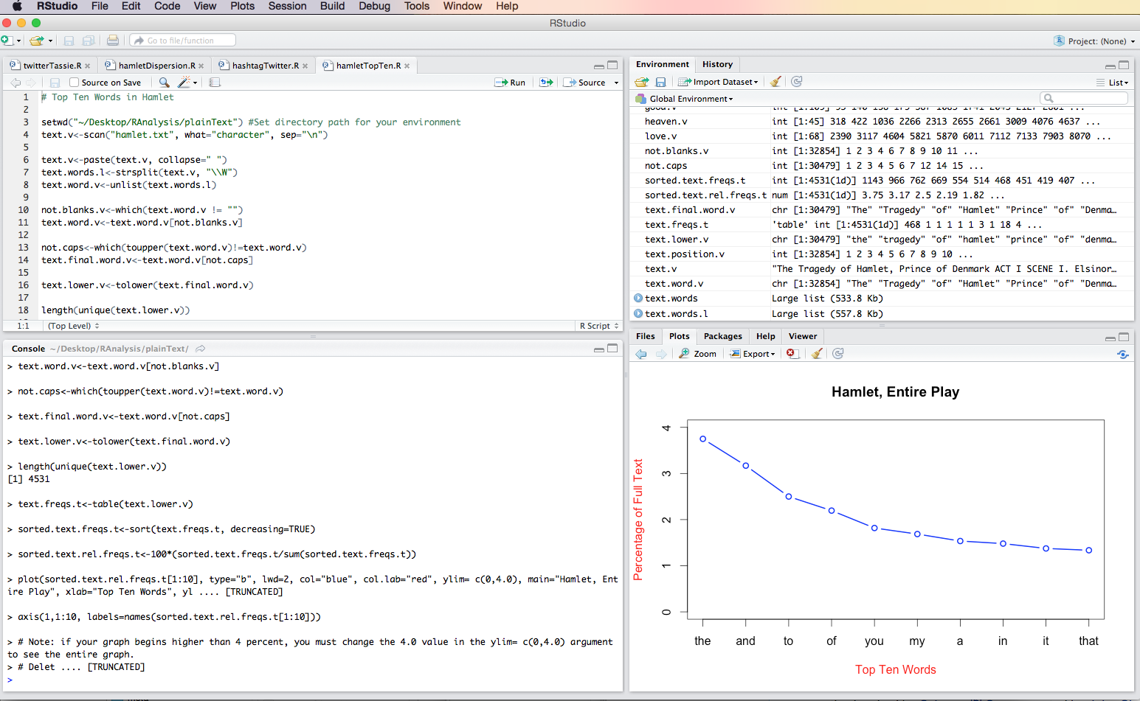
How do I use R?
While R can be used on the command line, RStudio provides a helpful interface.

Slide 4
Our Approach
Begin with easy visualizations, but explain how they can still provide insight (as above)
Make all code available on github: https://github.com/cyberdh/Text_Analysis
Provide a tutorial structure that uses
A Shiny web app in which the user can explore different parameters of the visualization
An RNotebook in which every line of code is fully explained (soon to be dynamic Jupyter Notebooks)
An RScript that can be downloaded and modified by the user

Slide 5
R and Literature
The CyberDH team has developed a workflow for those new to text analysis.
Isolate a text with which you are very familiar. In our case, we used Hamlet. This does not mean you won't learn something new!
Once you are confident in the results of the various outputs with this text, build out your corpus to perform some more complicated analysis. In our case, we then looked at the Shakespearean corpus.

Slide 6
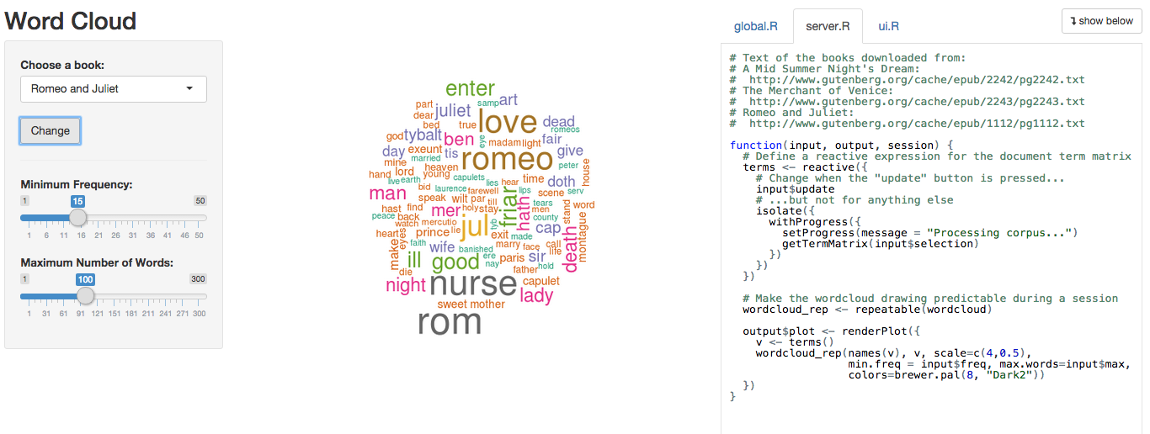
Your Expertise: Still Needed
http://shiny.rstudio.com/gallery/word-cloud.html

Slide 7
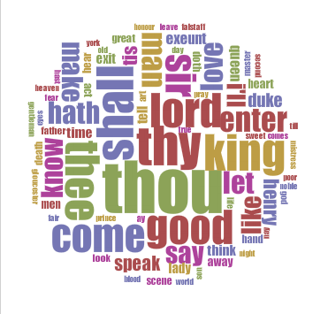
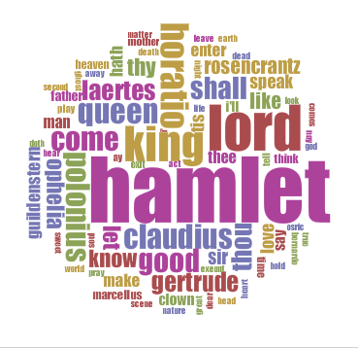
Voyant: Same problem, but not immediately evident.

Slide 8
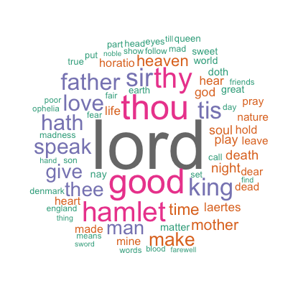
Voyant vs R Word Cloud with Speakers Removed

Slide 9
Let's follow a typical progression
We'll take a turn toward contemporary events and use twitter data culled last week in the wake of the shooting at the Pulse Nightclub in Orlando, Florida.

Slide 10
Why Use this Approach?
We believe that researchers who who beyond the black box will be better collaborators with professional statisticians and computer scientists. We don't expect our clients or the users of these scripts to tackle LDA on their own, but we find that giving them agency with these introductory algorithms facilitates onboarding, actually brings up some interesting research questions, and piques their interest to learn more.

Slide 11
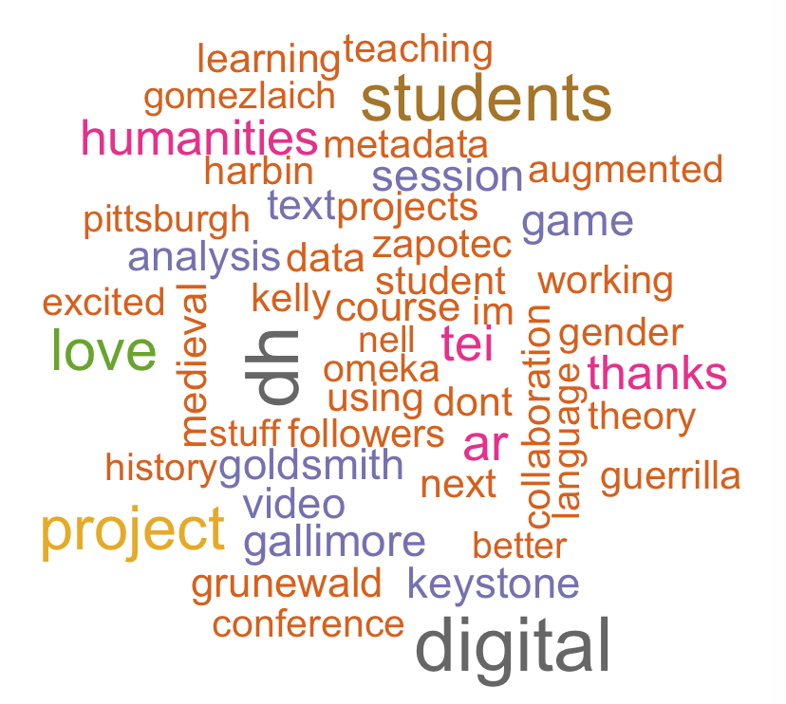
KeystoneDH is about love (and other stuff)!

